Slide 1
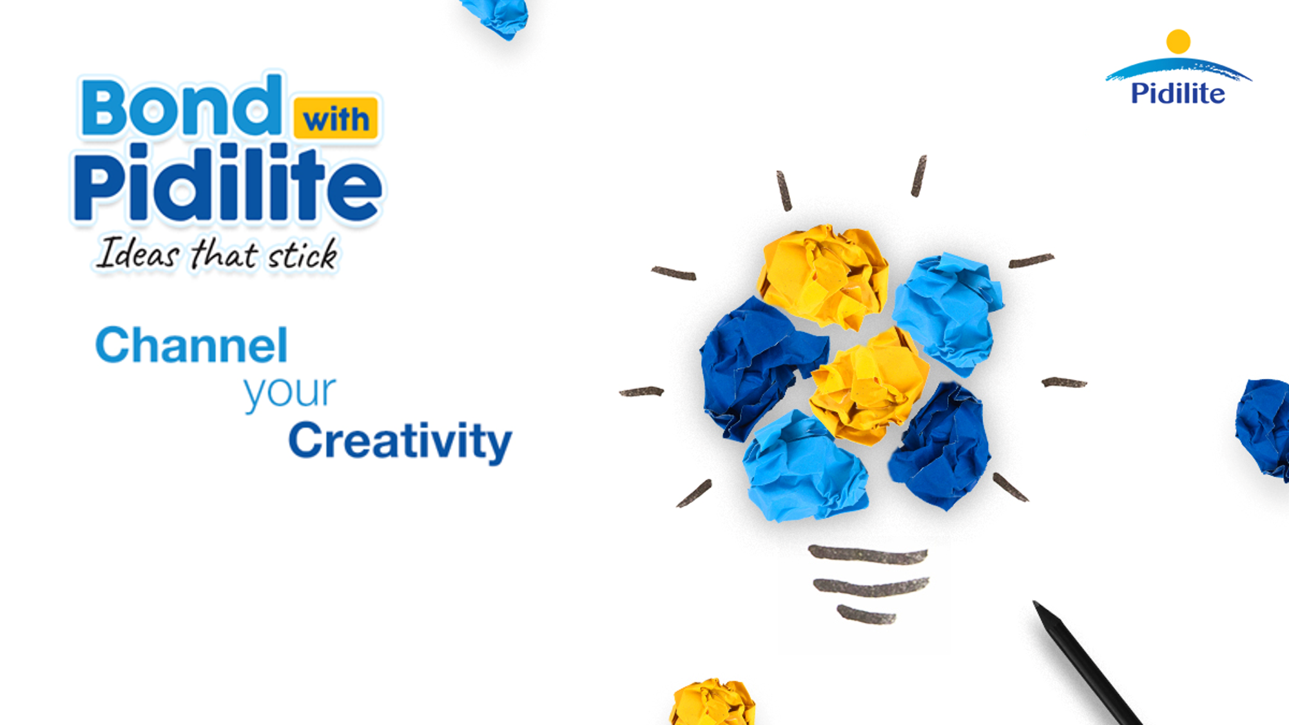
Team Name: Excelsior
Campus: IIM Shillong
Names of Team Members:
1. Priya Jain
2. Ojasvi Agrawal
3. Shrey Chheda

Slide 2
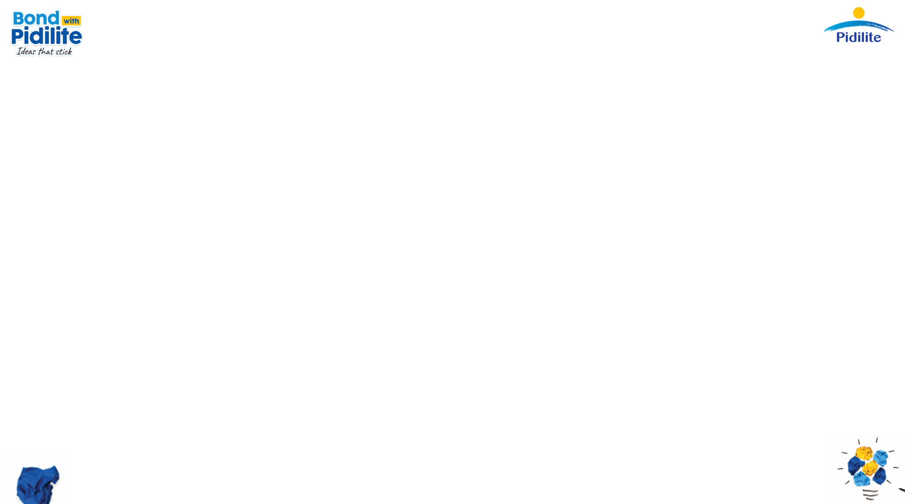
EXECUTIVE SUMMARY
Problem Statement & Objectives
The problem statement is to understand the product and portfolio, understand the customer and their insights, and identify the need gaps. It is about getting more users to the brand, to get users to use more, to get users to use often. To address these, the focus is on shifting the communication of the brand, identify the untapped market to add more consumers, and address the unfulfilled need of the consumer.
Approach
Overview
Market Research
Key Insights
Business Proposal
Communicating the Idea
Market Campaign
Recommendation & Conclusion
Target Customer
Cobblers – Daily quantity required is more; alternatives used do not meet the quality
Handicraft Artisans – Work-item has intricate detailing; options to carry out neat-work
DIY Artisans – Carry out sustainable work but the use of plastic glue sticks beats the purpose; alternatives are less cohesive and requires considerable time to stick
Communicating the Idea
Cobblers – Better value for money as one drop of Fevikwik does a better job than 5-8 drops of other adhesive.
Handicraft Artisans – Reduce their adhesive usage and time taken while also making the craft more aesthetic and appealing.
DIY Artisans – High social media engagement; will use a product if it has a mass appeal
Market Campaign
Driving the Behaviour Change to Creation along with repair– “AAO EK NAYA JOD BANAYE”
Use of Outbound Marketing and Broadcasting; Social media marketing to penetrate into the untapped market segment and explore the opportunities
Brand Penetration
Aggravating the on-ground executives
Radio, TV as a means of communication to capture their attention
Incentivize the distributors of the alternative products
Espouse the handicraft artisans with the benefits
Target social media / Instagram influencers involved extensively in DIY for paid promotions
Executive Summary
Business Model Canvas

Slide 3
THE BUSINESS MODEL CANVAS
Key Partners
Aggravating on-ground sales executive for targeted marketing
Incentivize the distributors who are currently selling alternative adhesives for pitching their customers of Fevikwik
Instagram influencers and handicraft artisans to use Fevikwik in their creations to portray itself as cool and artistic
Key Resources
Expansion via partnerships
Introduction of new thought along with the existing one
Broadcasting via traditional modes of communication
Value Proposition
Driving the consumers’ behavior towards creation which has otherwise been about fixation for a diverse portfolio
Better value for money as one drop of Fevikwik does a better job than 5-8 drops of other adhesive.
Reduce their adhesive usage and time taken while also making the craft more aesthetic and appealing.
Customer Relationships
Offer literacy of the use Fevikwik to segment needed
Portray consumers as cool and artistic people
Customer Segment
Cobblers – Daily quantity required is more; alternatives used do not meet the quality
Handicraft Artisans – Work-item has intricate detailing; options to carry out neat-work
DIY Artisans – Carry out sustainable work but the use of plastic glue sticks beats the purpose; alternatives are less cohesive and requires considerable time to stick
Key Activities
Expansion – Diversifying the portfolio of consumers of the product
Behavioural Change – Incorporating a different perspective of the product
Channels
Broadcasting
Outbound Marketing
Social-Media / Instagram Marketing
Cost Structure
Partnership Costs
Marketing and Customer Services Costs
On-field drives
Incentives to Distributors
Revenue Streams
Market share increments
Existing usage increment of sales
Executive Summary
Business Model Canvas

Slide 4
OVERVIEW
Pidilite Industries Limited
Journey of Fevikwik
Inception in 1959 Pioneer in consumer and specialties chemicals in India Market leader in adhesives Diverse product portfolio from adhesives, sealants, waterproofing solutions and construction chemicals to arts & crafts, and it is ever-evolving Robust and growing network, products are accessible across demographics and geographies Brands in the portfolio have become trusted household and industrial names across the country and beyond
More than three decades of existence Pioneer of instant adhesives in India and the undisputed category leader More than 70% market share Legendary iconic campaigns, solid distribution strength and efficacy of product, it has become a household name Inexorable leadership stance despite the challenges by duplicate brands, me-too players and aggressive Chinese imports Available in a variety of pack sizes including a handy Rs. 5 SKUs, and can be bought at hardware stores, kirana's, stationery outlets, etc.
Fevikwik – What Next?
Fevikwik – Until Now!
Increase the brand scores on salience, likeability, and brand appeal Change the target audience's perception from repair Taking Fevikwik towards a new horizon by adding a new perspective of MAKING THINGS, not just fixing things
Broke the tradition to create a shift in its communications and target audience, and at the same time expand the category Despite being the pioneer of instant adhesives, growth slow down Realized it had to chart a fresh course Switched its focus to the ‘Woman of the House’, to widen usage and aid growth, using a TV based campaign to highlight its ease of use and help women become more confident repairers. The campaign succeeded with results exceeding all expectations, helping revive growth Backing such growth, the task now is to chart the next strategic course and aiding brand growth
Overview
Communicating the Idea
Market Campaign
Market Research
Observations
Business Proposal

Slide 5
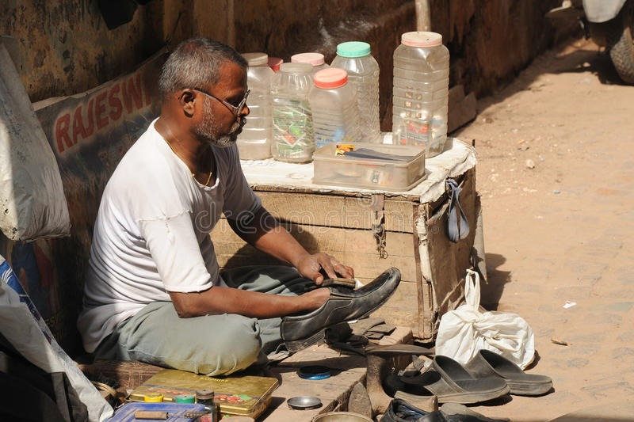
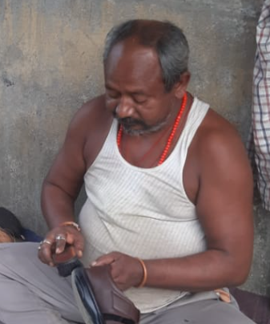
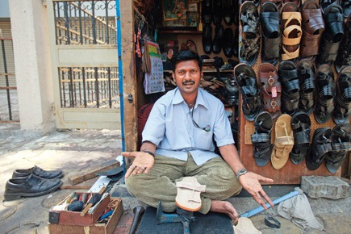
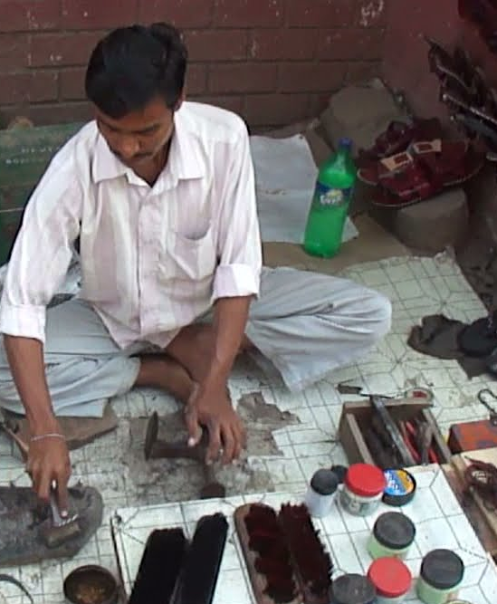

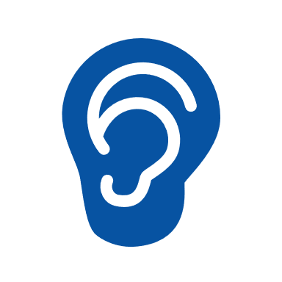
MARKET RESEARCH
The Invisible Man On the Streets
Babulal, Outside the Railway Station, Guwahati
“On a Good day by God’s Grace I get around 50 customers”
Nandu, In a crowded market area in Mumbai
“I get around 50-60 customers in a day”
Hari, At the Bus Stop in Biaora, Madhya Pradesh
“On an average I get 20-25 customers per day”
The Cobbler
Current Adhesive
Current Adhesive
Current Adhesive
Local flowy Glue
Dendrite
Sakti bond
Purchased from
Purchased from
Purchased from
Local retailers
Wholesale market
Distributor
How much adhesive used per customer
How much adhesive used per customer
How much adhesive used per customer
12 : Urban 6 : Rural 4 : Semi-Urban
Why do you use the current adhesive?
Why do you use the current adhesive?
Why do you use the current adhesive?
8-10 drops
5-6 drops
8-10 drops
22
Cheapest adhesive, Easily Available
Strong adhesive, Sticks well
Affordable and the only one available
20 : Know about Fevikwik 12 : Used Fevikwik
before
Shortcomings of the current alternative?
Takes time to stick. Less cohesive
Shortcomings of the current alternative?
Supply is less in the market
Shortcomings of the current alternative?
Customer complain that the glue fades away very easily
Heard about Fevikwik?
Ever used Fevikwik?
Heard about Fevikwik?
Ever used Fevikwik?
Heard about Fevikwik?
Ever used Fevikwik?
Willingness to Shift
14 : YES 3 : NO 5 : MAYBE
Yes
Yes
Yes
No
No
No
Any issues faced with Fevikwik?
Any issues faced with Fevikwik?
Any issues faced with Fevikwik?
Any issues faced with Fevikwik?
22
5 Rs pack Dries up easily and cannot be reused after opened
Not Applicable
Not cost effective
Overview
Communicating the Idea
Market Campaign
Market Research
Observations
Business Proposal

Slide 6
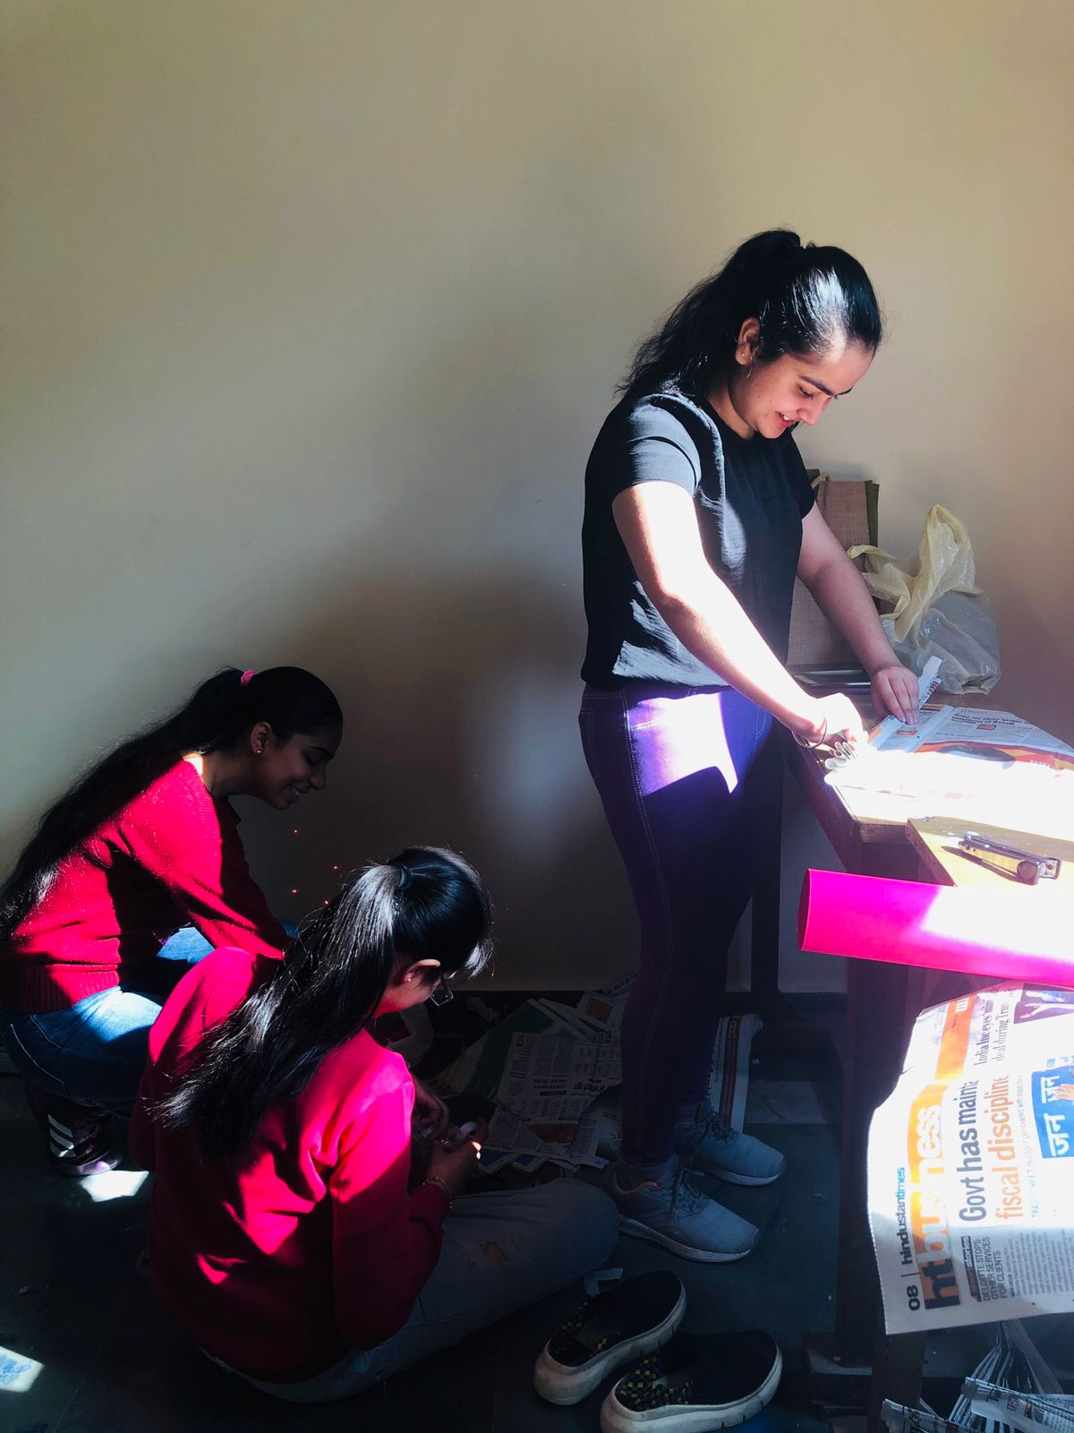
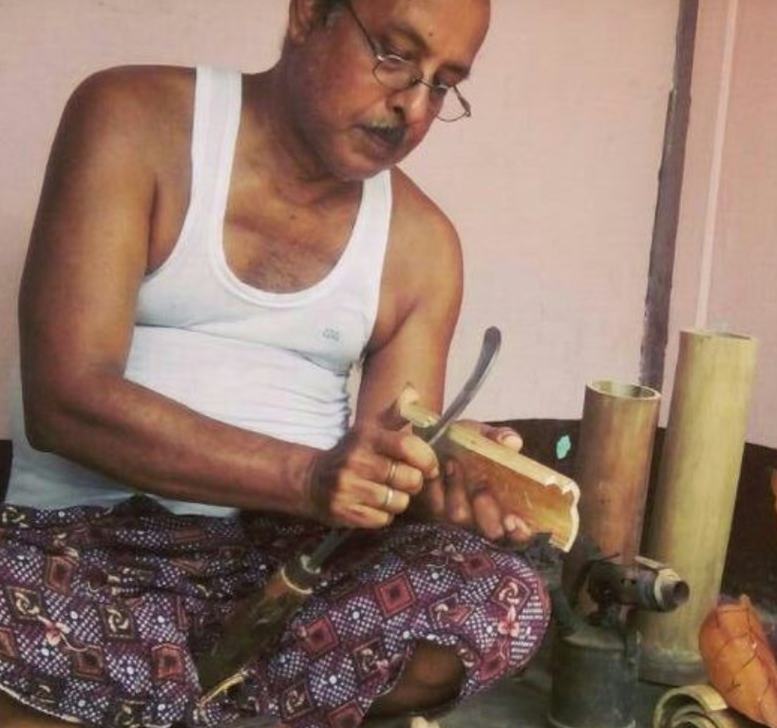
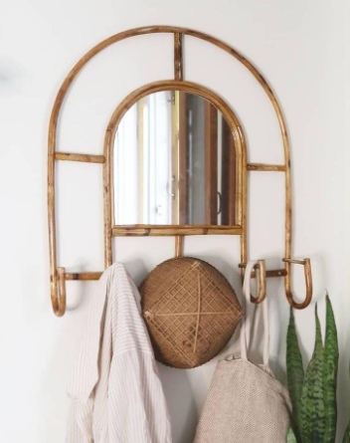
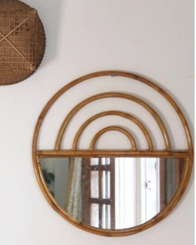
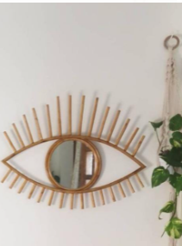
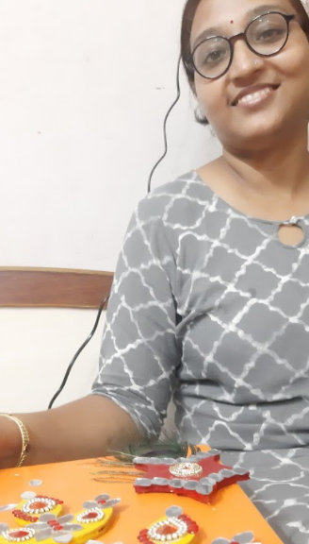
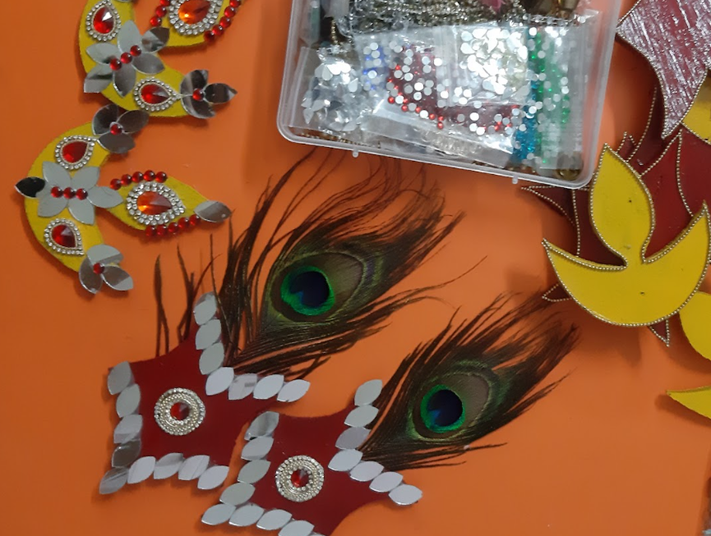
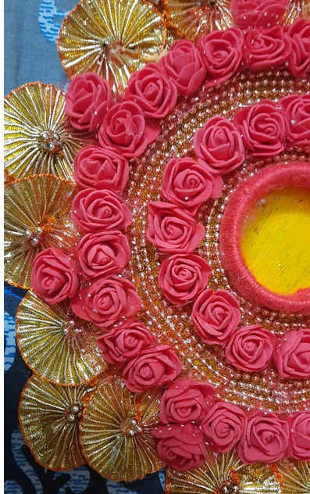
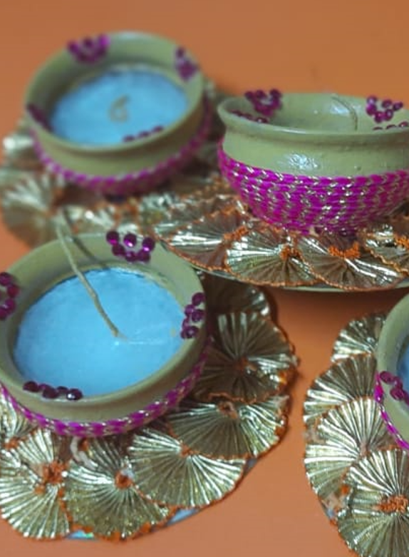
MARKET RESEARCH
The Creators of the
real essence of India
Sonu, Makes handicraft items in Guwahati
“On an average, we sell 30-40 items in a week”
How much adhesive used per item
Shortcomings of the current alternative?
Heard about Fevikwik?
Any issues faced with Fevikwik?
The Handicraft Artisan
Yes
1 tube
Ever used Fevikwik?
Requires a large amount for a single item Takes time to stick Less Cohesive
Unaware about the applications
Current Adhesive
Why do you use the current adhesive?
No
Chinese Adhesive
Purchased From
Traditional practice of the family
Local Distributors
5 : Urban 2 : Rural 3 : Semi-Urban
10
Sakshi, Makes handicraft items in Udaipur
“We sell nearly 80 items in a week to tourists”
How much adhesive used per item
Shortcomings of the current alternative?
Heard about Fevikwik?
Any issues faced with Fevikwik?
10 : Know about Fevikwik 8 : Used Fevikwik
before
Yes
1/4th of a tube
Ever used Fevikwik?
Current Adhesive
Why do you use the current adhesive?
Final outcome is not very smooth Sometimes the craft work looks messy
Not cost effective
Bondtite
Yes
Willingness to
Shift
6 : YES 1 : NO 3 : MAYBE
Cheapest Available Adhesive, Entire market uses it
Purchased From
10
Local Retailers
Overview
Communicating the Idea
Market Campaign
Market Research
Observations
Business Proposal

Slide 7
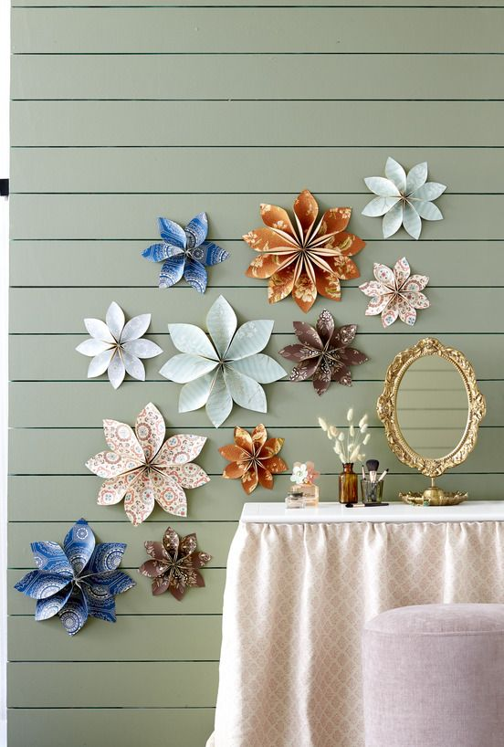
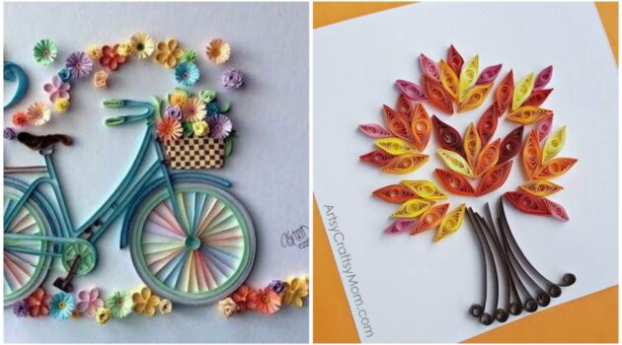
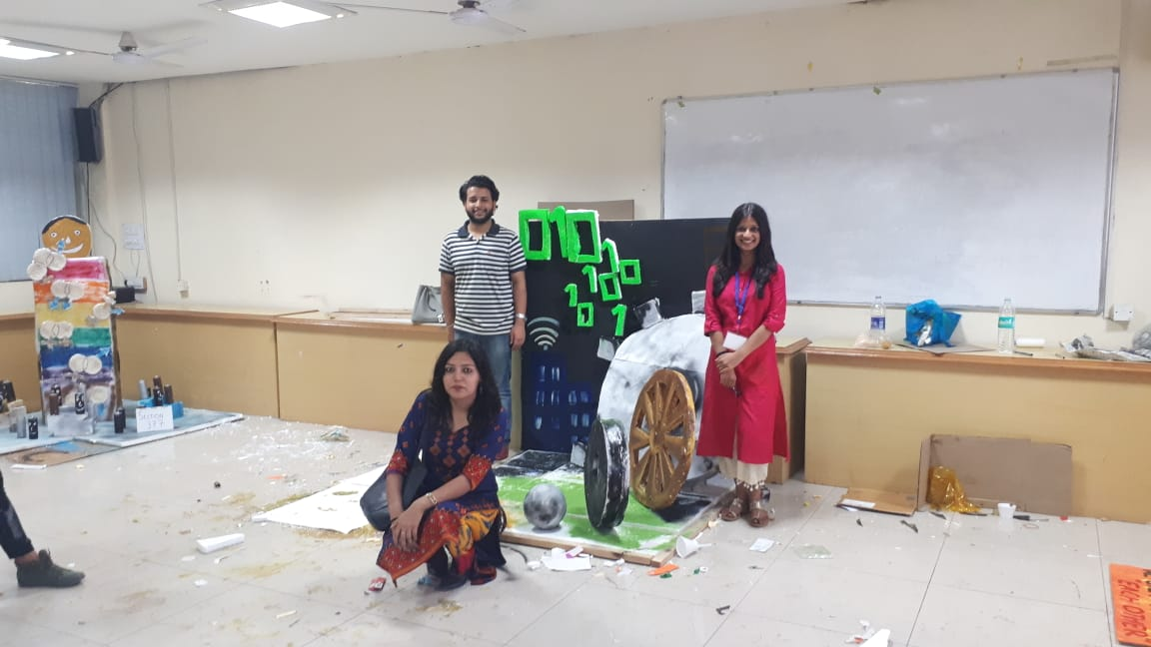
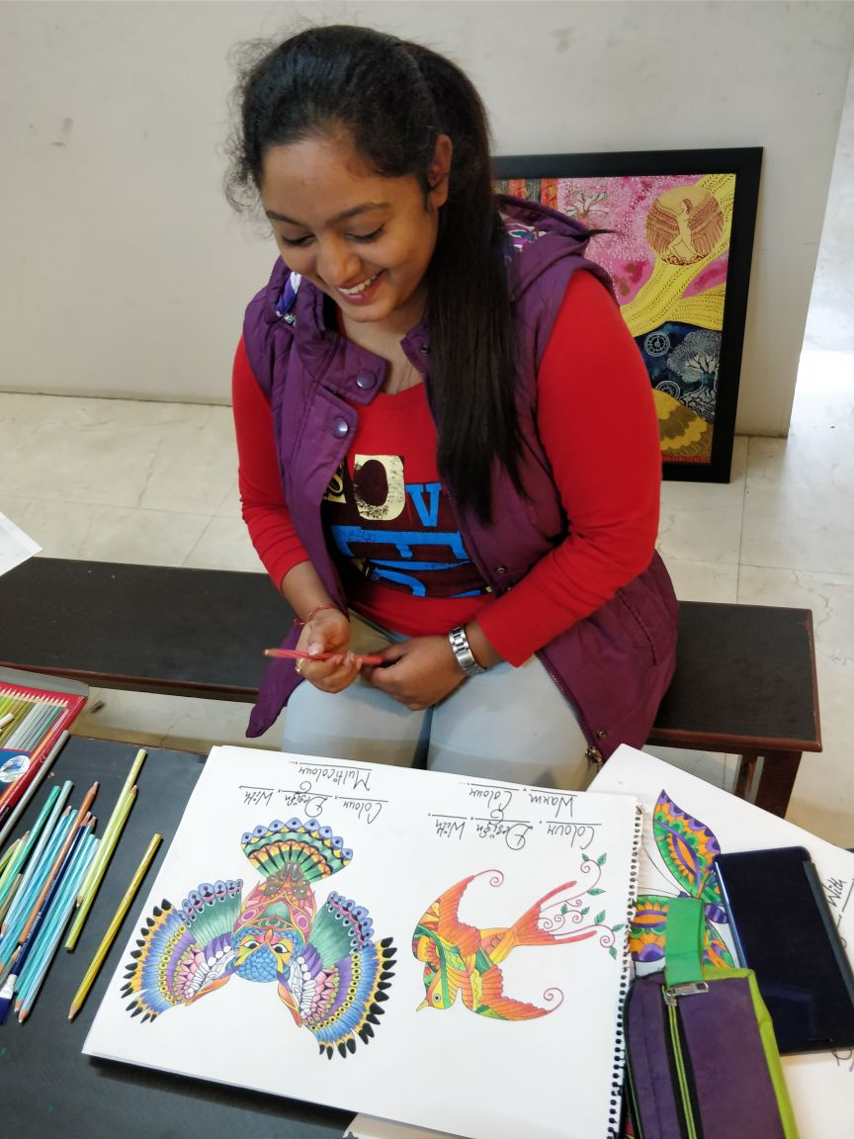
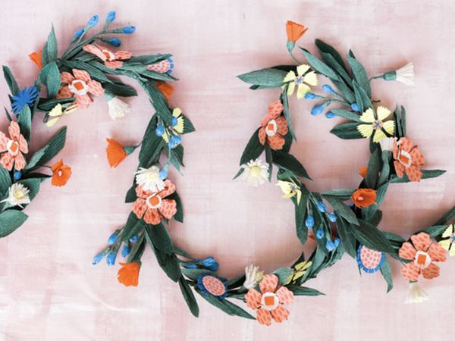
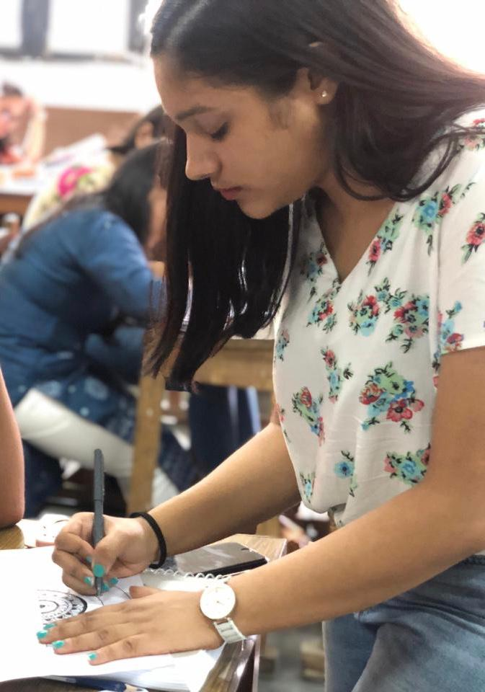
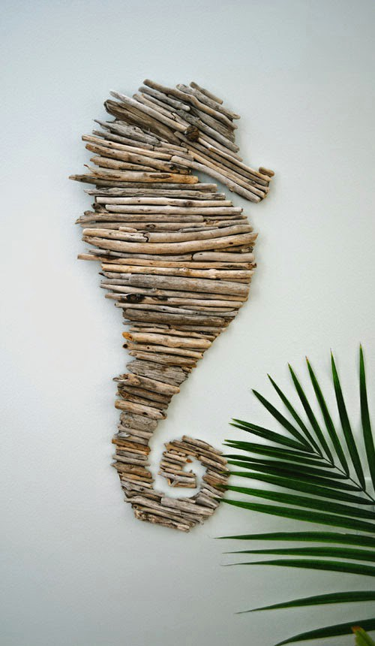
MARKET RESEARCH
The Creators on Social Media
Medha, Business for personalized DIY items
“I get 2-3 clients in a week who ask for creating gift items”
Why do you use the current adhesive?
Ever used Fevikwik?
The DIY Artists
Yes
Easily available
Current Adhesive
Shortcomings of the current adhesive?
Any issues faced with Fevikwik?
Glue gun, Sticks
Purchased from?
It is made of plastic so, unsustainable A little Messy
Local retailers
How much adhesive used/item?
Dries up after the cap of the 5rs pack is opened
Heard about Fevikwik?
8 : Urban 3 : Rural 4 : Semi-Urban
2-3 sticks per item
Yes
15
“I get 1-2 clients per month with multiple gift packaging order”
Why do you use the current adhesive?
Ever used Fevikwik?
Neha, Business for event based gift packaging
15 : Know about Fevikwik 14 : Have used Fevikwik before
Cost effective
Yes
Current Adhesive
Shortcomings of the current adhesive?
Any issues faced with Fevikwik?
Glue Gun, Dendrite
Willingness to Shift
13 : YES 0 : NO 2 : MAYBE
Purchased from?
Less Cohesive Time consuming
Wholesale shop
5 Rs pack which is available doesn’t seem very cost effective
15
How much adhesive used/item?
Heard about Fevikwik?
30-40 sticks/event
Yes
Overview
Communicating the Idea
Market Campaign
Market Research
Observations
Business Proposal

Slide 8
OBSERVATIONS
Adhesive Used
Market Requirement
Cobblers
DIY Artists
Customers come in a hurry to get their shoes fixed
Cobblers end up losing 4/10 customers
Existing Adhesive takes time to stick
Adhesive Requirement in High Quantity
Recurrent Adhesive Consumption
Faster Sticking Adhesive preferred
Quantity of Adhesive applied should be minimal as the surface area of the item is small
Environmental friendly items (Reuse & Recycle). Glue Gun stick, made of plastic is unsustainable and defeats their purpose
Bondtite
Chinese Adhesive
High quantity of adhesive required on day to day basis
Current Adhesive perceived to be the cheaper option
Volume of adhesive used negates the Cost-Benefit
Glue Gun Sticks
Joker Glue
Local Flowy Glue
The glue material of glue sticks are not very strong adhesive
Dendrite
Sakti Bond
DIY Artists use the glue guns as it looks aesthetically pleasing and lends a touch of superiority to their social media videos
Handicraft Artisans
The glue from the glue gun takes a lot of space in their craft material, leaving less space for decoration
Current Adhesive being unable to hold decorative materials properly
Artisans end up using more adhesive, which restricts the space for decorations
Intricate detailing in handicrafts need to be spotless and aesthetically pleasing; hence, lesser the usage of adhesive, better the end-product
Current adhesives requires time to stick, which make the artisans frustrated
The plastic threads from the glue stick makes their craft look messy and unclean
Overview
Communicating the Idea
Market Campaign
Market Research
Observations
Business Proposal

Slide 9
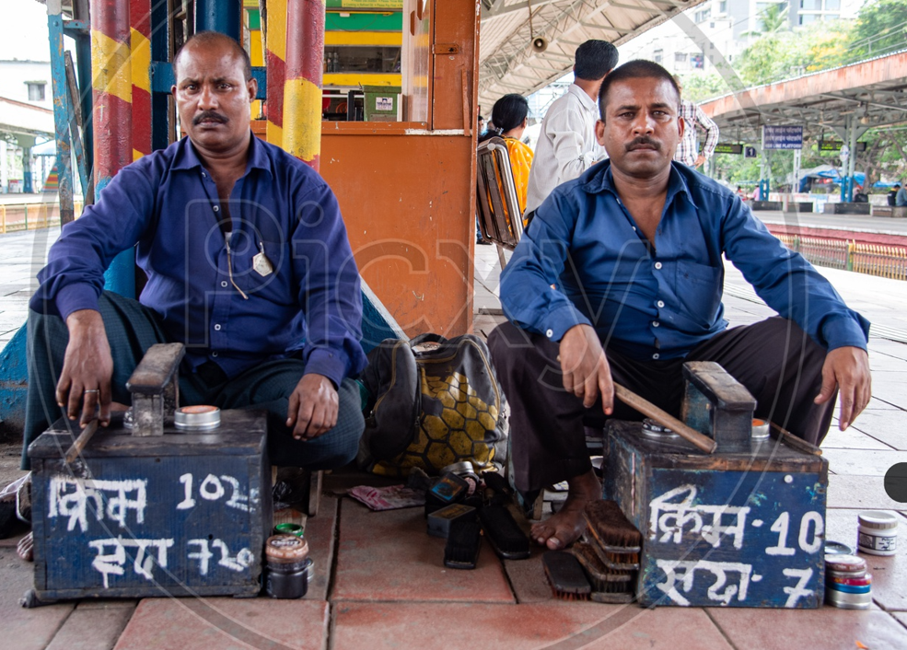
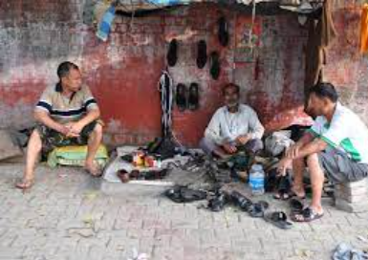
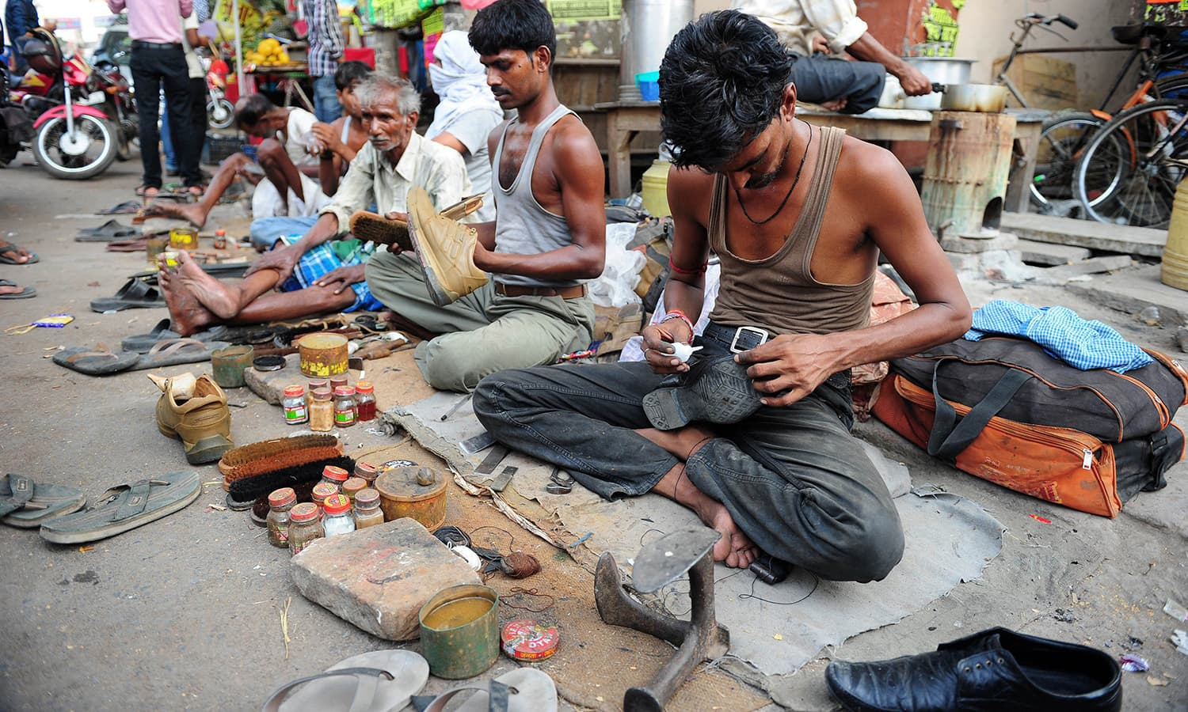
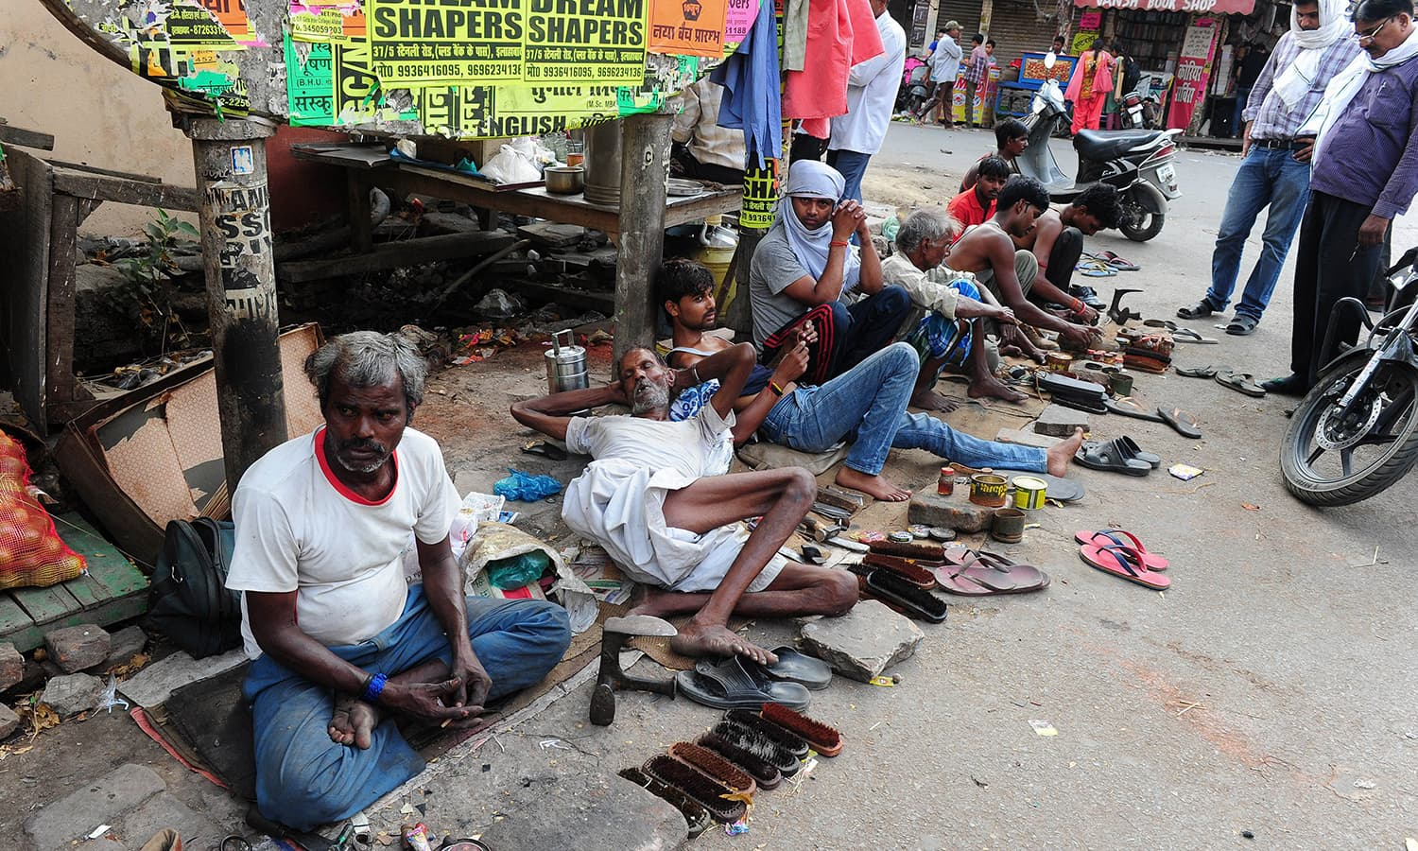
COMMUNICATING THE IDEA
Building a Majboot Jod with Cobblers
Approximately 266,000 cobblers in the country, sitting at the Nukkads and Corners of the streets of India
Spread awareness about the instant stick characteristic and the consequent uptick in revenues for the cobblers owing to less time required
The Cobbler Community is a very tightly knit community living together in harmony
They are seen to follow community trends and have the power to influence each other’s decisions
Savings arising from cheaper alternatives is negated by the extra volume of those adhesives used to stick the shoe soles and bags
Premise
Solutions
If targeted campaigns are run to attract influential members, other will soon follow
‘Aao Ek Naya Jod Banaye’ campaign should be expanded to include the shoes manufactured by the cobblers at their shop. Good quality products will ensure future sales as well
High volume and regular consumption merits special focus
Overview
Communicating the Idea
Market Campaign
Market Research
Observations
Business Proposal

Slide 10
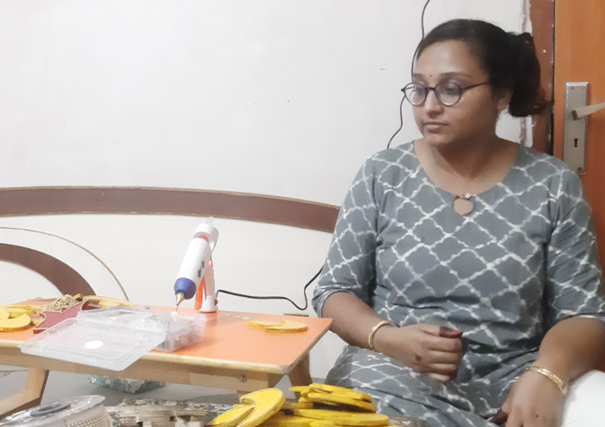
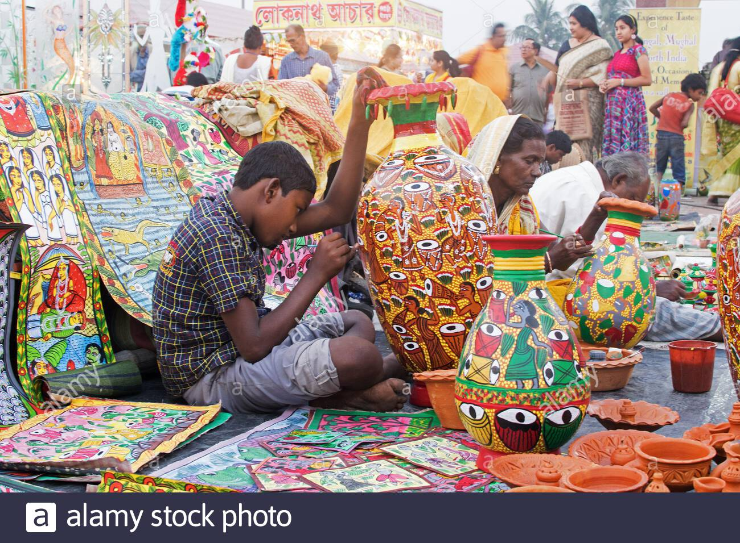
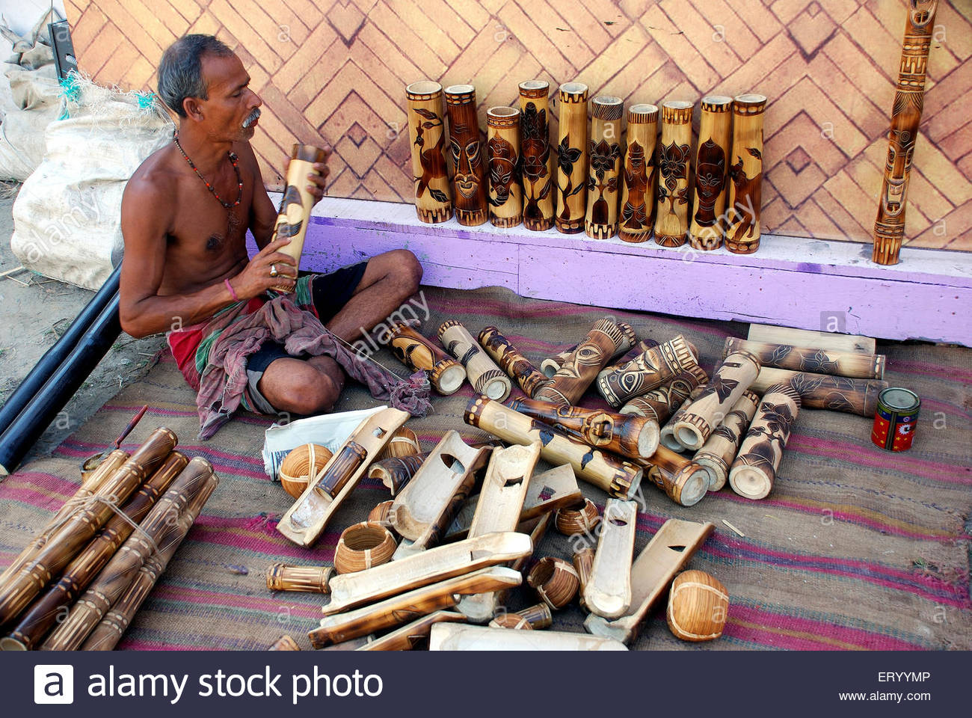
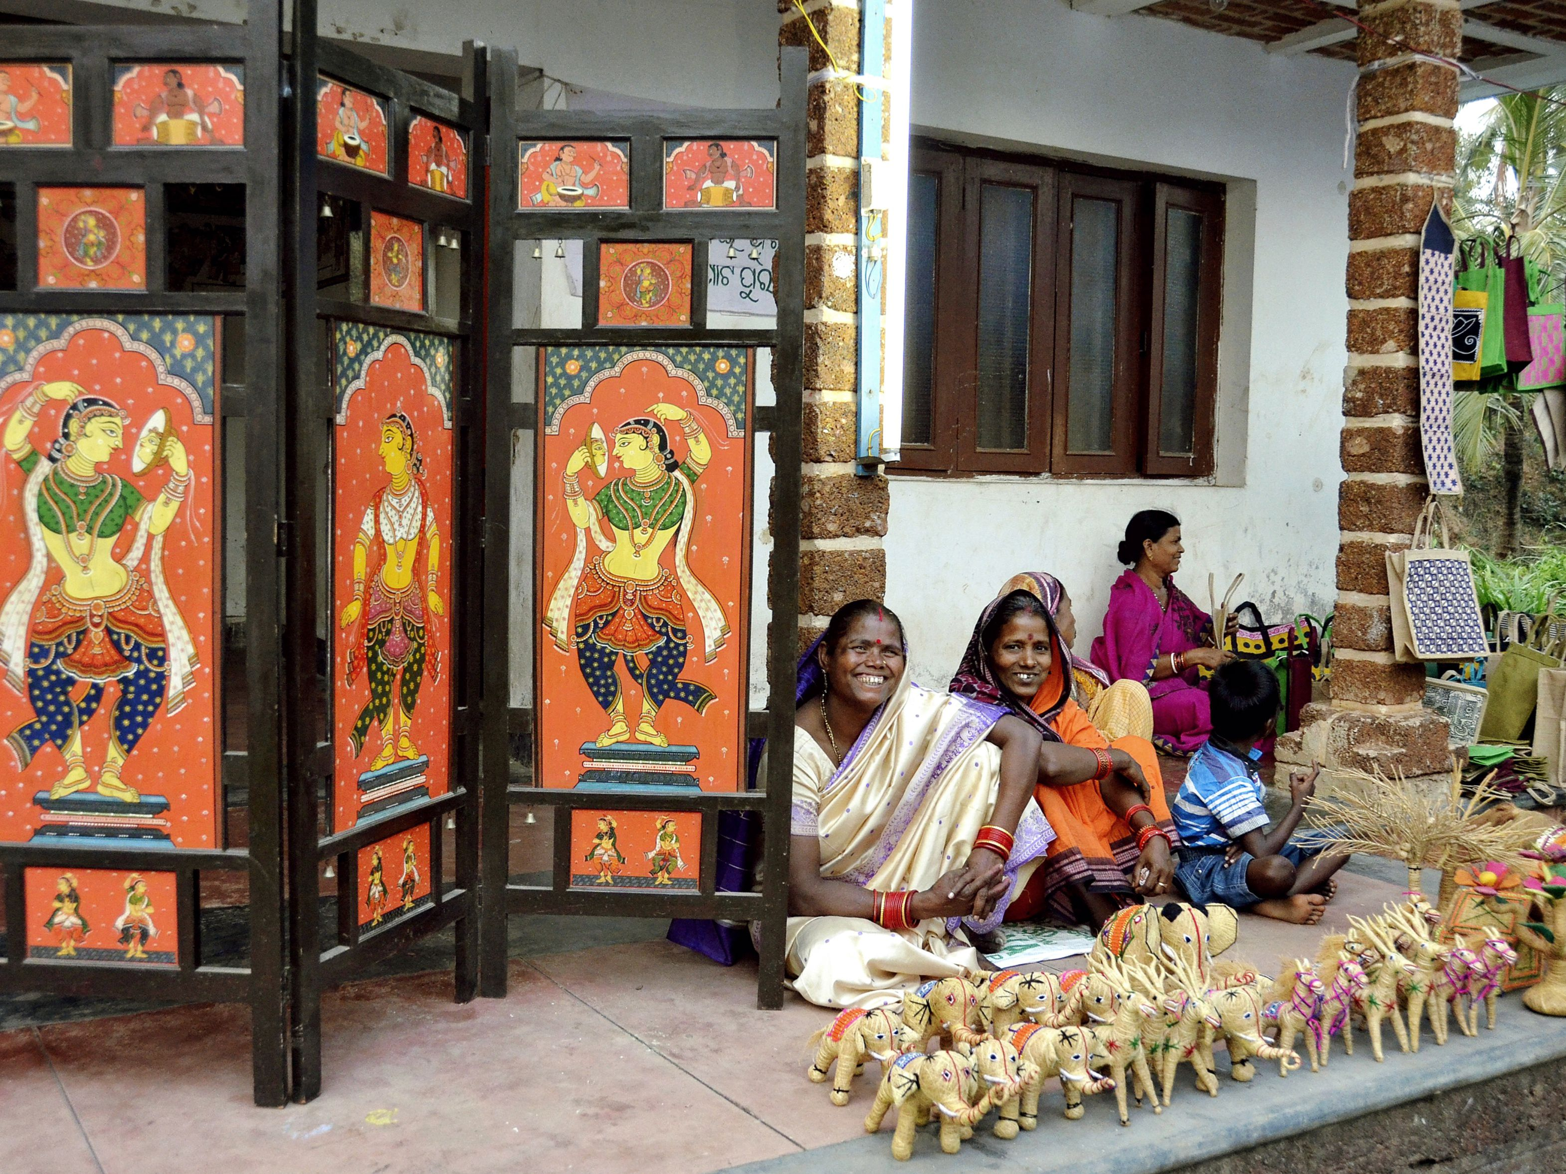
COMMUNICATING THE IDEA
Building a Majboot Jod with Handicraft Artists
Majority of the market is in semi-urban and rural areas
Efforts to be made to reach out to Artisans who are in clusters. The sale executives can ensure maximum conversion by resolving most of the pain points of the segment that are effectively addressed by Fevikwik
Majority are found in clusters
High Growth, High Margin market which use large quantities of adhesives
The raw material suppliers are generally the ones who also fulfil the adhesive requirements of the artisans
Premise
Solutions
Artisans consider adhesives to be add-ons
Naya Jod must be made with the raw materials suppliers of these artisans. They should be offered special sales-based incentives. Sales figures will see a marked upward push
With proper strategy this market can be easily tapped
Overview
Communicating the Idea
Market Campaign
Market Research
Observations
Business Proposal

Slide 11
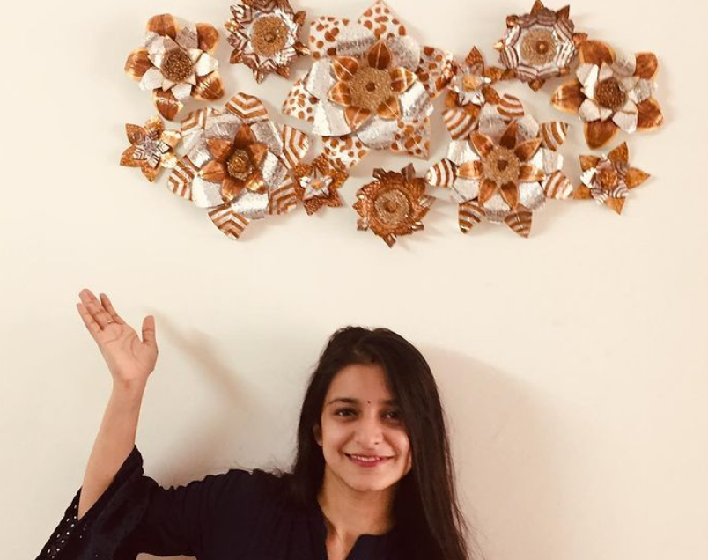
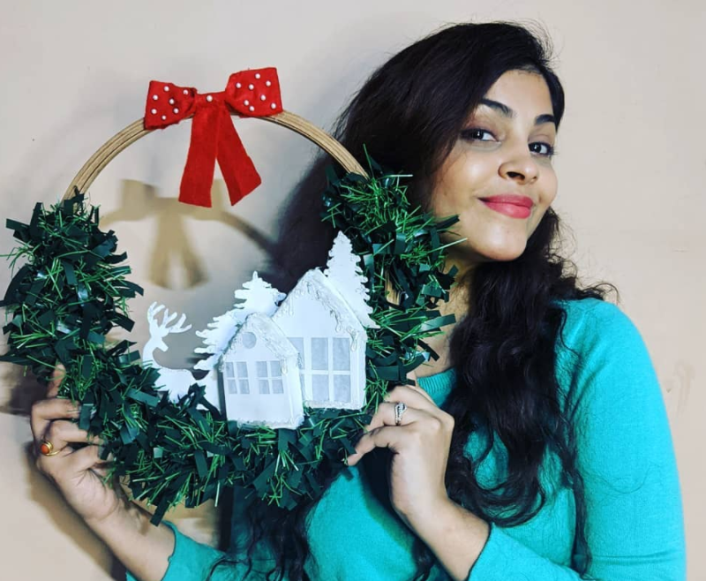
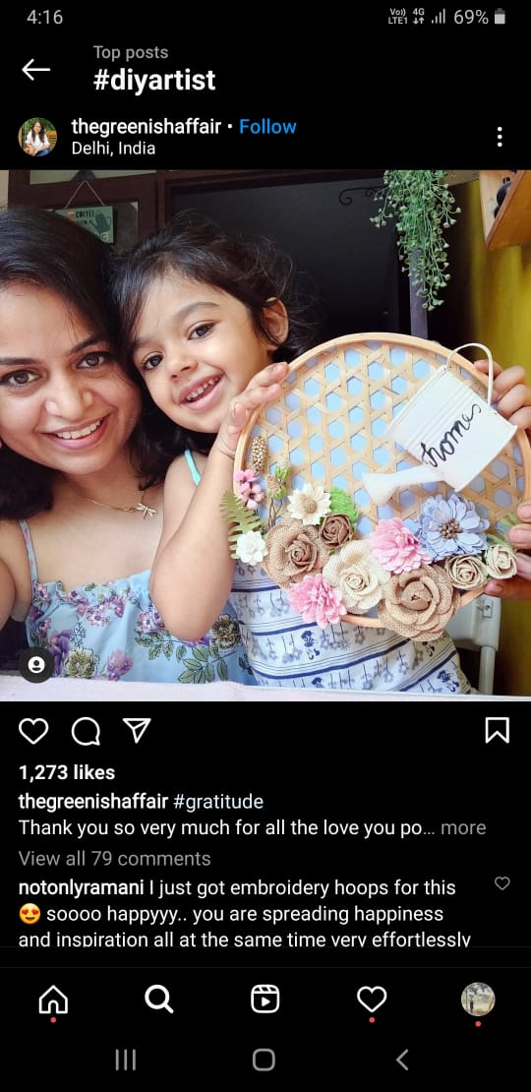
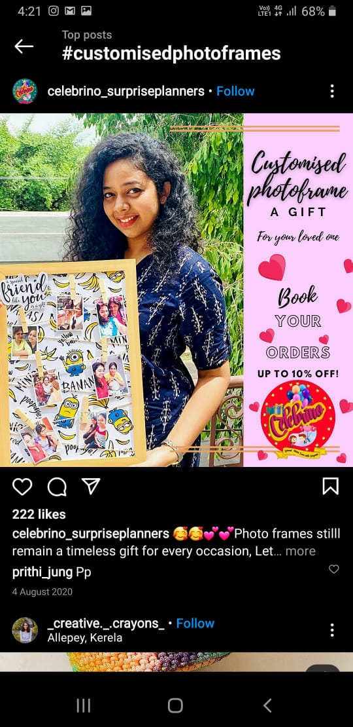
COMMUNICATING THE IDEA
Building a Majboot Jod with DIY Artists
One of the bright side of pandemic is that people have found time to pursue their passion
User perception needs to be changed viz. Fevikwik should be made to look more desirable as compared to the glue gun which are in use currently
DIY arts is one such area which has seen a major affinity among patrons
Glue Guns use plastic pellets which is in stark opposition to the most central idea of DIY, i.e. sustainability. This fact to be fully leveraged to position Fevikwik as the best alternative available
There is an opportunity for Pidilite to capture this segment
Solutions
Premise
The volume consumed and the frequency of consumption is quite lucrative to be missed
Also, Fevikwik solves a fundamental pain point of maintaining aesthetics of the DIY art as lower quantities are needed to provide a better, stronger and a cleaner “Jod”
Artists are already aware about the benefits of the product but use Glue Guns as it is in vogue
Overview
Communicating the Idea
Market Campaign
Market Research
Observations
Business Proposal

Slide 12
MARKETING CAMPAIGN
Chalo Milkar Khushiyaan Failayein with Cobblers and Handicraft Artisans
Taking Fevikwik towards a new horizon by adding a new perspective of MAKING THINGS, not just fixing things
Broadcasting and Outbound Marketing
Educate and Spread Awareness
Aggravate the On-Ground Sales Executives
Promotional Channel
Quite busy managing their own shops , they are connected via Radios and TVs mostly, owing to their small shop sizes
They are also not very active on digital platforms to know about any kind of promotional activities
Catchy Advertisements should be broadcasted on Radio, TV and should be used as a means of communication to capture their attention
Extensive promotion through billboards at Chouraha and Nukkad showcasing how Fevikwik is a perfect match for their work
Putting up convincing Posters and Banners around the shops where the cobblers and artisans usually go to purchase their adhesives
Fevikwik gives a better value for money as one drop of Fevikwik does a better job than 5-8 drops of other adhesive
As the cheapest product always takes precedence for them. They need to be communicated about the difference between cost cutting and cost optimization
Create advertisements depicting how these people are the real essence of India and at the same time convey the message about the benefits of Fevikwik
As the Cobblers and Artisans are a tightly knit community with an ability to influence each other’s decisions
The On-Ground Executives need to reach out to these specific members of the community to successfully tap the entire cobbler and handicraft artisans community
Demonstrate about the benefits of Fevikwik to these specific people as this increases the chance of them getting influenced to use Fevikwik
The retailers and wholesalers of the alternative adhesive need to be incentivized based on “Increased Sales = Increased Discounts & Benefits”
Train the Retailers and Wholesalers to pitch Fevikwik to the customers
Less Quantity Required
Clean Work
Needs Less Surface Area
Long lasting quality work
Sticks Faster
Overview
Communicating the Idea
Market Campaign
Market Research
Observations
Business Proposal

Slide 13
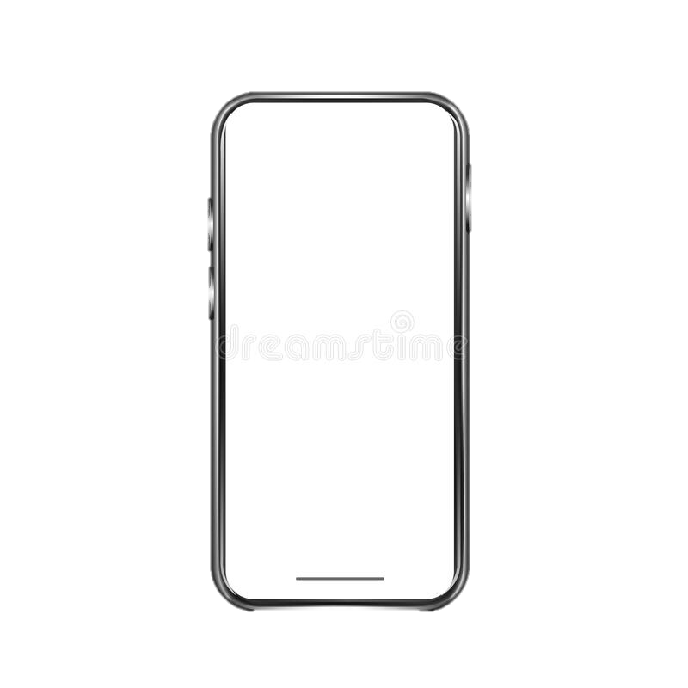
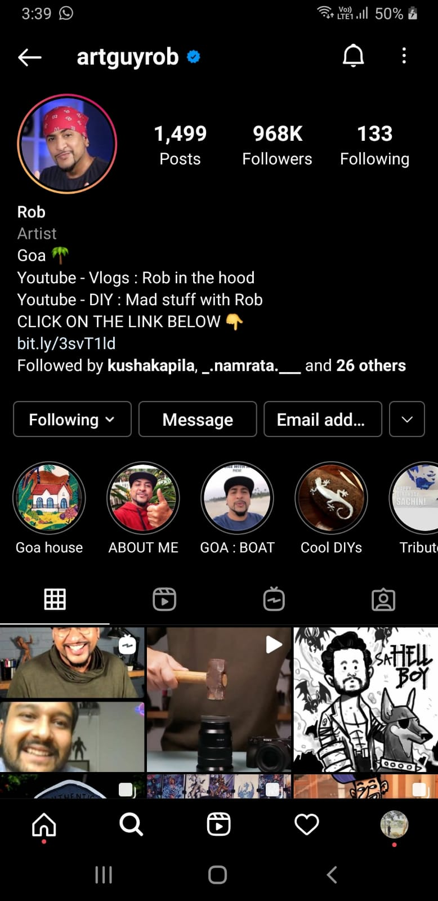
MARKET CAMPAIGN
Chalo Milkar Khushiyaan Failayein with DIY Artists
Taking Fevikwik towards a new horizon by adding a new perspective of MAKING THINGS, not just fixing things
Social Media Marketing
Create The Trend
Promotional Channel
Launch a Social Media Arm for the campaign “Aao Ek Naya Jod Banaye” to strike an emotional chord with the masses by creating relevant hashtags, Instagram Reel, YouTube Shorts trends etc.
Target famous DIY influencers with a reach of more than 100K followers or subscribers, and tie up with them by providing them sponsorships and making them use Fevikwik extensively in their Social Media posts
Showcase Fevikwik as a quintessential product in the videos and how it can be used to create quality craft items
Launch advertisements on social media targeted at the DIY Artists and tell about how Fevikwik is a sustainable product
DIY Artists use Social Media as the primary medium to get customers and increase their reach
Their main purpose is to create artistic crafts which are environment friendly by reusing and recycling waste or discarded items
The essence of Aesthetics and Coolness in their social media posts is one of the biggest influencing factors for them
This community preach and follow trends by famous social media influencers
Overview
Communicating the Idea
Market Campaign
Market Research
Observations
Business Proposal

Slide 14
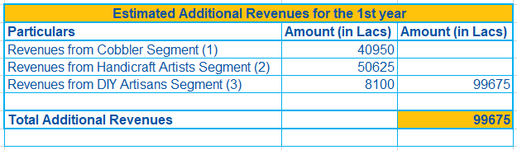
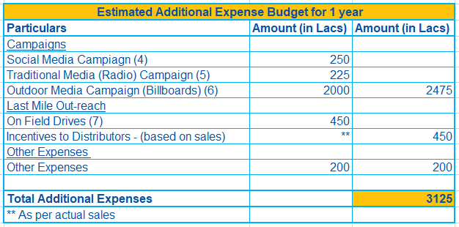
BUSINESS PROPOSAL
Synthesis
By spending an additional Rs. 31.25 Crores, there is an opportunity to earn an additional revenue of Rs. 996.75 Crores
The revenues from various segments are for a period of 1 year
Assumptions
Assumption taken that costs and revenue shall be incurred and earned for a foreseeable future, i.e., one year
Calculations for points (1) to (7) are shown in the appendix
For the sake of brevity, assumed that the revenues and costs shall be earned and incurred evenly
Total targetable market and target market arrived at by using guesstimates and workings in appendix
Overview
Communicating the Idea
Market Campaign
Market Research
Observations
Business Proposal

Slide 15
BUSINESS PROPOSAL
Controlled Pilot Launch
Instagram Campaign for DIY Artisans
For Handicrafts: Udaipur (Rajasthan)
For Cobblers: Mumbai (Maharashtra)
Usage Literacy Drive
Pilot Phase 2
Target PAN India on the likes of the controlled launch
Track of the revenue numbers
Jan 2022
April2022
July
2022
Oct
2022
Background Study
Identification of the Pilot Segments and Cities where the campaign is going to be launched
Pilot Phase 1
Activated DIY Artisans; more influencers onboarding
Tapping distributors of the product and incentivize them
Pilot Phase 3
Push the on-ground executives to increase sales
Focus on profits from PAN India
State (Rajasthan) | Target Population (Handicraft Artisans) | Criteria to choose
Udaipur | 2000 | Handicraft work is very prevalent in the city
State (Maharashtra) | Target Population (Cobblers) | Criteria to choose
Mumbai | 2500 | More number of cobblers because of the high population density
Cities | Geo Targeting | SEO Optimization | Usage Literacy Drive | Social Media Campaigns | Billboards
Udaipur for Handicrafts | YES | NO | YES | NO | YES
Mumbai for Cobblers | YES | NO | YES | NO | YES
Expected Outcome | Category Penetration Brand Awareness On-ground Executive conduct targeted marketing | Category Penetration Brand Awareness | To demonstrate them how using the product can make their life easier and produce higher quality and save time and money | Activate the DIY Artisans PAN India and an easy way out as they are highly active on social media platforms | Visual Touch Points for each segment and help them remind about the product
Overview
Communicating the Idea
Market Campaign
Market Research
Observations
Business Proposal

Slide 16
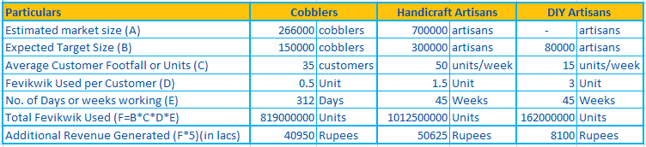
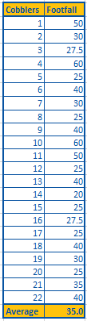
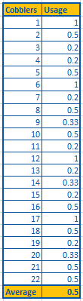
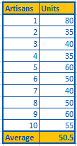
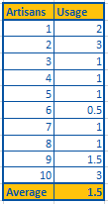
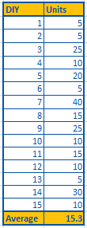
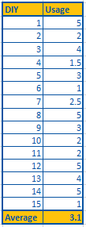
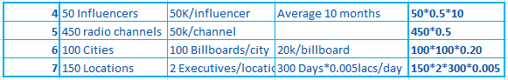
APPENDIX

Slide 17
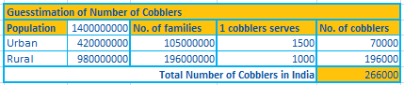
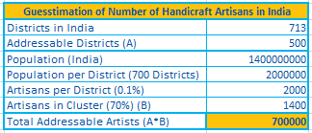
APPENDIX
Assumptions
Cobblers Guesstimate
Population of India estimated to be 140 crores
Urban-Rural Divide : 30-70
Population density in Urban areas is higher hence, estimated greater number of families served per cobbler as compared to rural India
Handicraft Guesstimate
Population of India estimated to be 140 crores
Generally, each district has its own unique art and handicraft. However, ~200 districts excluded to include urban districts and districts where handicraft doesn’t use adhesives.
Population bifurcated into districts assuming 700 districts for the sake of calculation brevity.
A very conservation estimate taken to arrive at the percent of Artisans – 0.1%
Estimated artisans found in cluster taken to be 70% with the remaining 30% kept aside to accommodate artisans spread across the entire district.

Slide 18
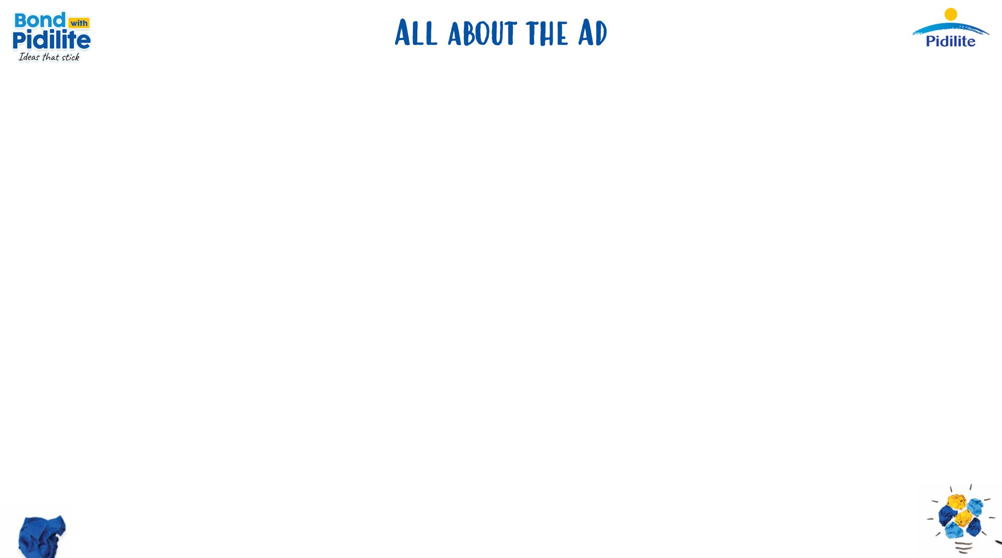



Click Here
https://www.instagram.com/p/CTrYXkYIMHf/?utm_medium=copy_link
Likes – 915
Views – 2198
Comments – 415

